Slide 1
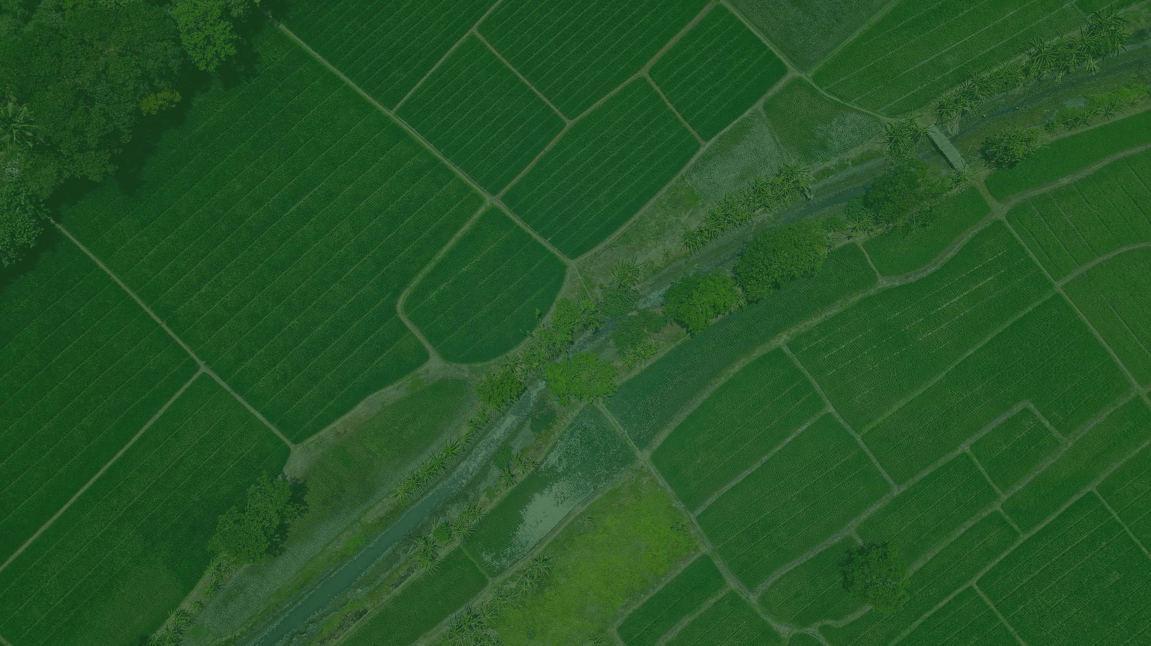

Empowering Sudan’s Agriculture with Space Technology
Salford & Co.
Utilizing HAPS, Drones, AI, 5G, and ArcGIS for Agricultural Growth
Abdelwahab Rayis
Afraa Rayis

Slide 2
Smart Agriculture:
Sudan’s agriculture sector is the backbone of its economy, providing livelihoods for millions and contributing significantly to food security and exports.
However, the sector faces major challenges, including:
Climate Change: Unpredictable rainfall, desertification, and frequent droughts reduce productivity.
Water Scarcity: Limited access to irrigation and inefficient water management in large agricultural zones.
Limited Resources: Lack of modern technology and precision farming practices lead to low yields.
To overcome these challenges, Smart Agriculture—powered by space-based technologies, AI, and geospatial systems—presents a revolutionary opportunity to enhance efficiency, increase crop yields, and build climate resilience.

Slide 3
Why is Space Technology Important to Agriculture in Sudan?
Large-Scale Monitoring: Sudan’s vast and diverse landscapes require extensive monitoring and management.
Remote Sensing: Space-based and near-space platforms (like HAPS) provide critical data on:
Climate patterns
Soil conditions
Crop health
Geospatial Technologies: Tools like ArcGIS help analyze and manage these resources, essential for improving resilience in farming.

Slide 4
Space Resources in Agriculture
Advanced Tools for Agriculture: The space industry provides cutting-edge tools such as satellite imagery, climate data, and enhanced connectivity, which are vital for modern agriculture.
Data Collection with HAPS and Drones: High-Altitude Platform Systems (HAPS) and drones collect detailed data on crop health, soil conditions, and environmental factors, crucial for agricultural analysis.
Visualization and Decision-Making with ArcGIS: Platforms like ArcGIS help visualize and interpret data, allowing farmers to make informed decisions based on real-time insights.
Enhanced Monitoring for Productivity: These space-based resources enable efficient monitoring of large agricultural zones, optimize resource use, and increase productivity, especially in rural areas like Sudan.

Slide 5
Technological Foundations for Smart Agriculture
To Achieve Our Goal of Smart Agriculture, We Need:
HAPS (High-Altitude Platform Systems)
Solar-powered, near-space platforms designed for extended, wide-area monitoring and data collection over vast agricultural regions, supporting long-term agricultural surveillance.
Drones
Low-altitude, agile devices that provide detailed, real-time data collection and enable precise interventions, such as targeted spraying and crop health monitoring.
AI (Artificial Intelligence)
Advanced algorithms process complex datasets from HAPS, drones, and ArcGIS, delivering actionable insights, predictive analytics, and decision-making support to optimize agricultural operations.
5G Technology
High-speed, low-latency network that ensures seamless data transmission and connectivity, enabling real-time analysis and rapid decision-making capabilities.
ArcGIS
A sophisticated spatial analysis and visualization platform that transforms raw data into actionable maps and insights, aiding in effective farm management and optimal resource allocation.

Slide 6
HAPS (High-Altitude Platform Systems)
Definition: High-Altitude Platform Systems (HAPS) are long-endurance, high-altitude aircraft that provide observation or communication services similar to artificial satellites. They can be solar-powered, hydrogen-fueled, or use conventional aviation fuels.
General Benefits: HAPS can offer continuous monitoring and communication services over large areas, making them valuable for various applications including weather monitoring, disaster response, and border security.
Agricultural Benefits:
Continuous Monitoring: Solar-powered HAPS platforms provide continuous monitoring of large areas, capturing multispectral and thermal imagery for monitoring soil moisture, crop health, and climate conditions.
Data for Decision Making: Critical for large farming areas, as HAPS provides data across diverse landscapes, supporting irrigation and planting decisions.

Slide 7
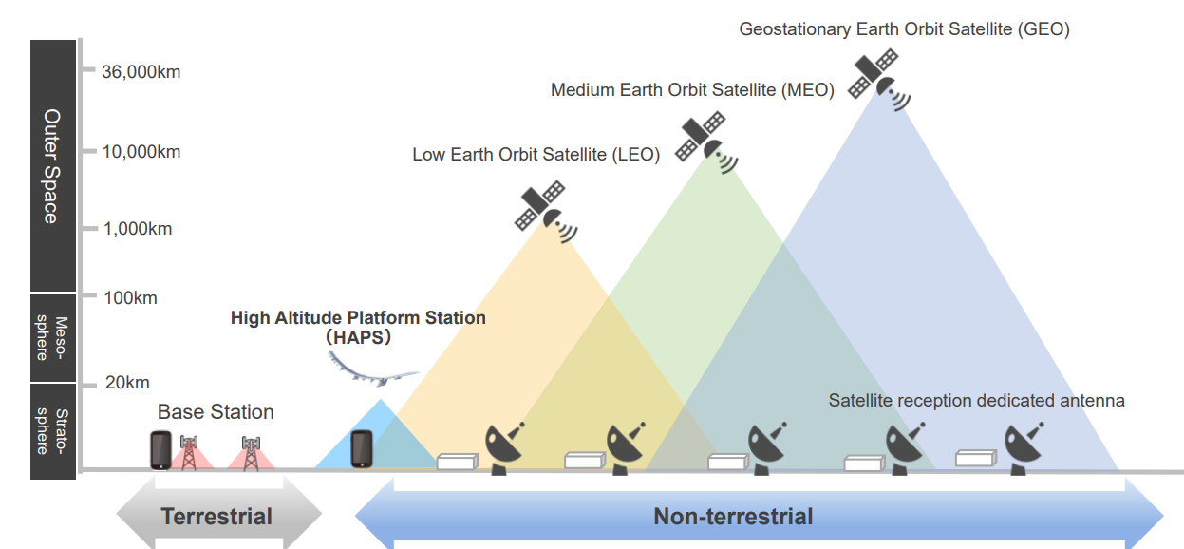

Slide 8
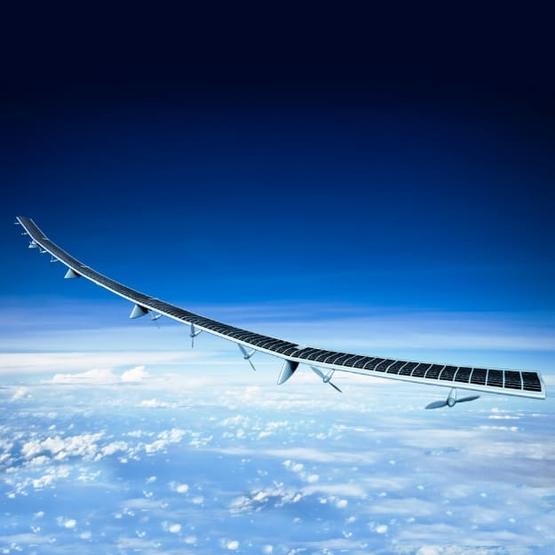
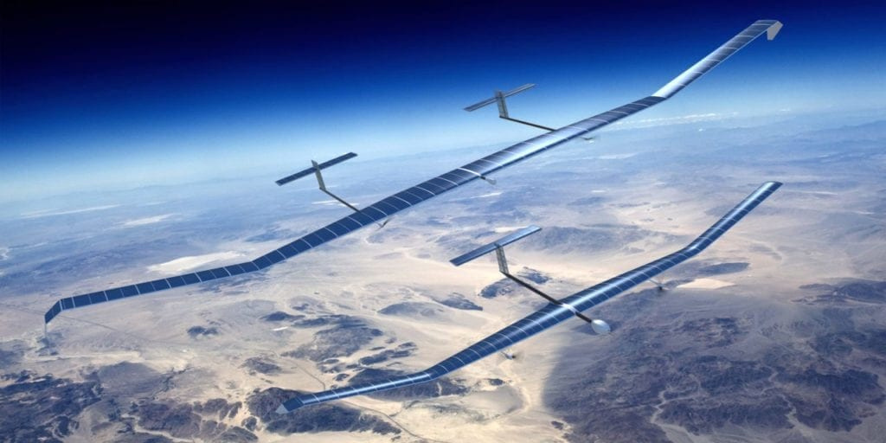
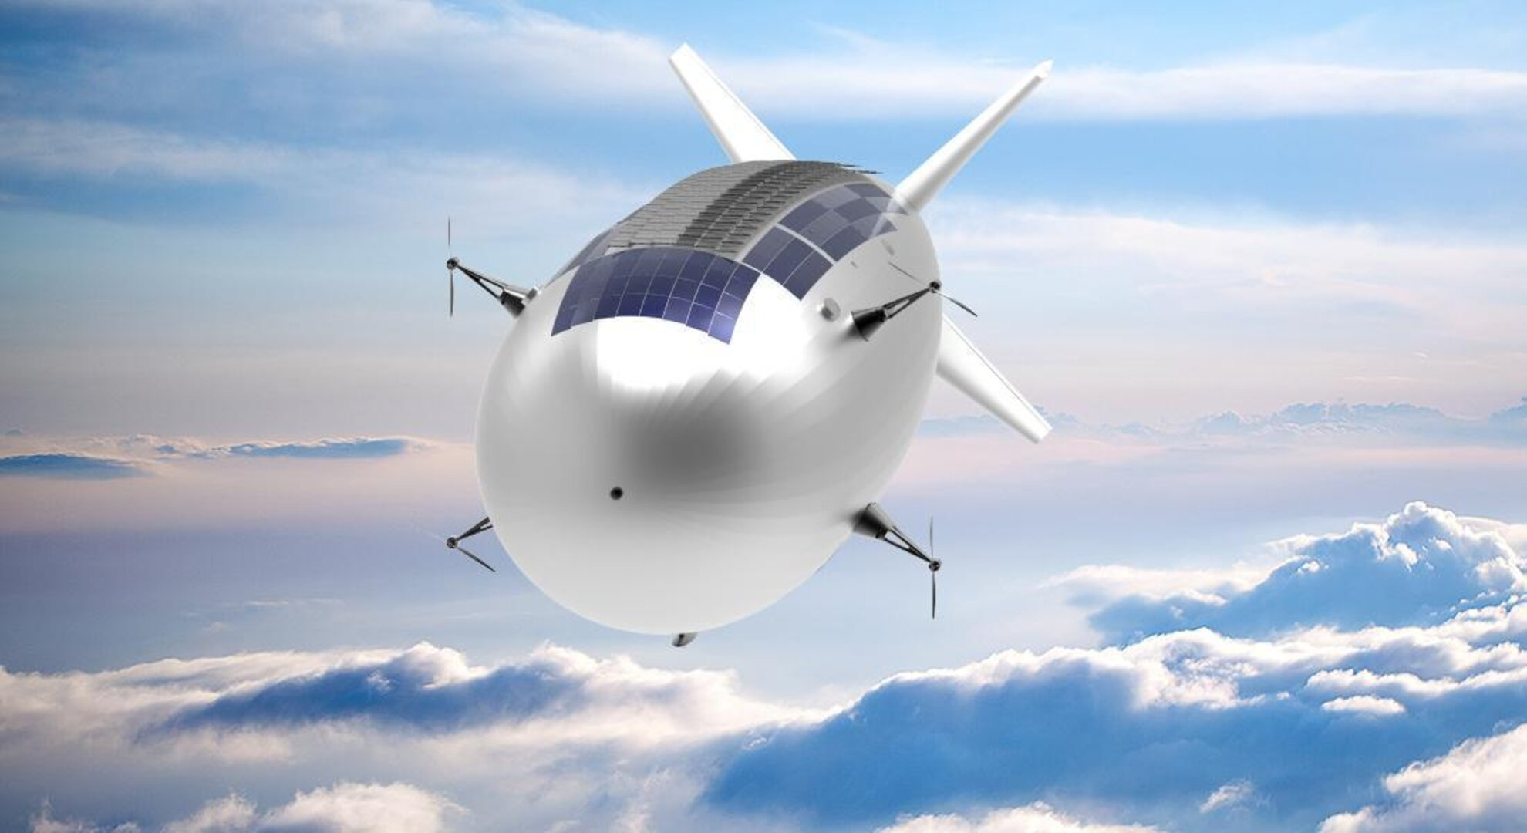
HAPS (High-Altitude Platform Systems)
•HAPS Complementary to satellites:
No orbital constraints -> very flexible trajectory ->higher update rate.
Higher spatial resolution and precision possible.
Much cheaper -> easier to use more systems (constellations).
Requires less heavy infrastructure in operation.
Can be very rapidly deployed.
Easier change of the payload
•HAPS Complementary to manned aircrafts:
Real time possible.
Less constraints from air traffic control.
Can be used in not optimal weather.
Can hover above a limited ROI.
Offer equivalent performances.
Mostly much cheaper.

Slide 9
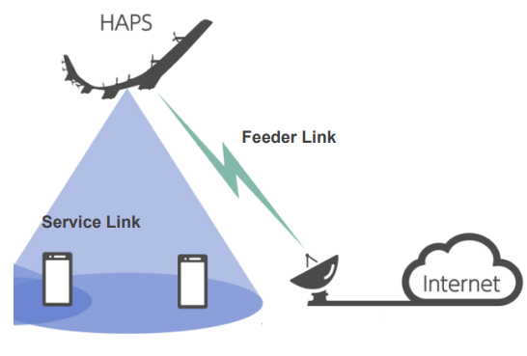

Slide 10
Drones Tecnology
Definition: Drones, also known as unmanned aerial vehicles (UAVs), are aircraft without a human pilot on board. They are controlled remotely or autonomously by onboard computers.
General Benefits: Drones are used in various fields for tasks such as surveillance, delivery, and environmental monitoring. They provide high-resolution imagery and data collection capabilities, making them valuable for precision tasks.
Agricultural Benefits:
Localized Data Collection: Drones offer localized data collection, delivering precise information on crop conditions and real-time health assessments.
Targeted Applications: Useful for applying fertilizers, spraying pesticides, and close-up monitoring of specific crops.
Complementing HAPS: Drones complement HAPS by allowing for more detailed, localized data collection and targeted interventions. HAPS, equipped with AI and ArcGIS, can guide drones on their missions, enhancing the precision and efficiency of agricultural operations. This integration allows for seamless planning and execution of drone flights, providing valuable context and situational awareness during missions.

Slide 11
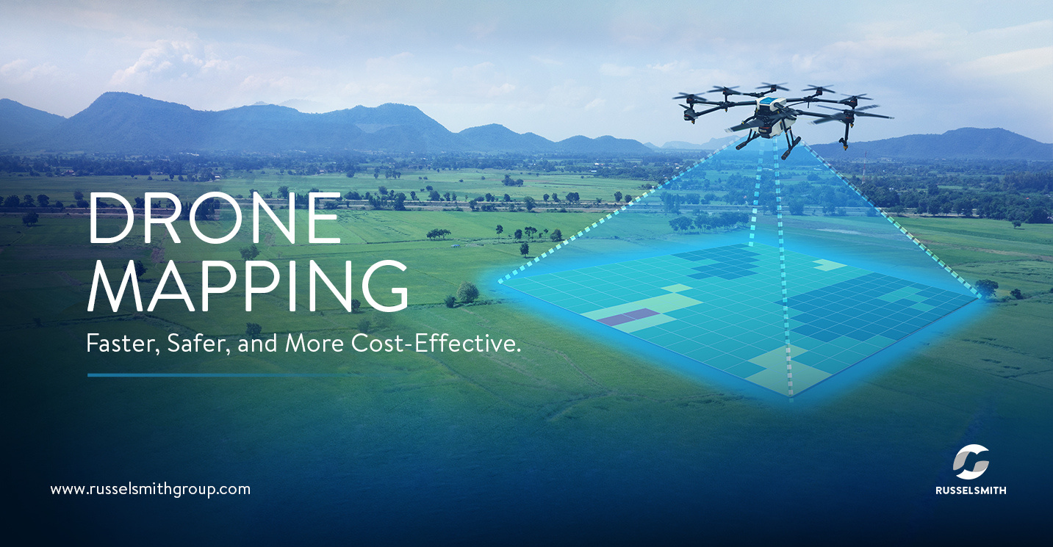
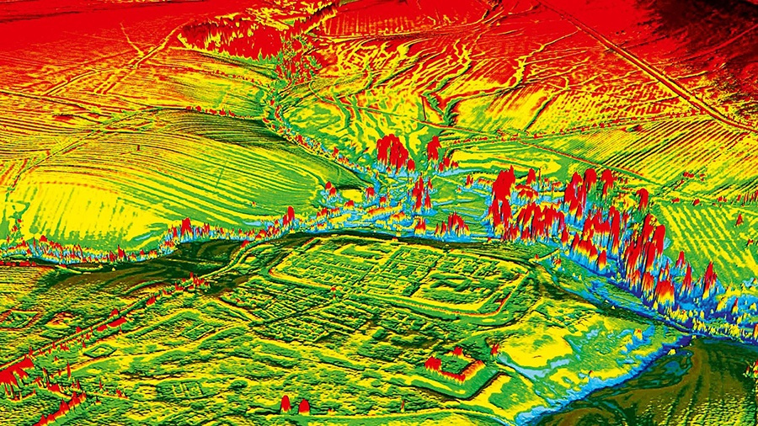
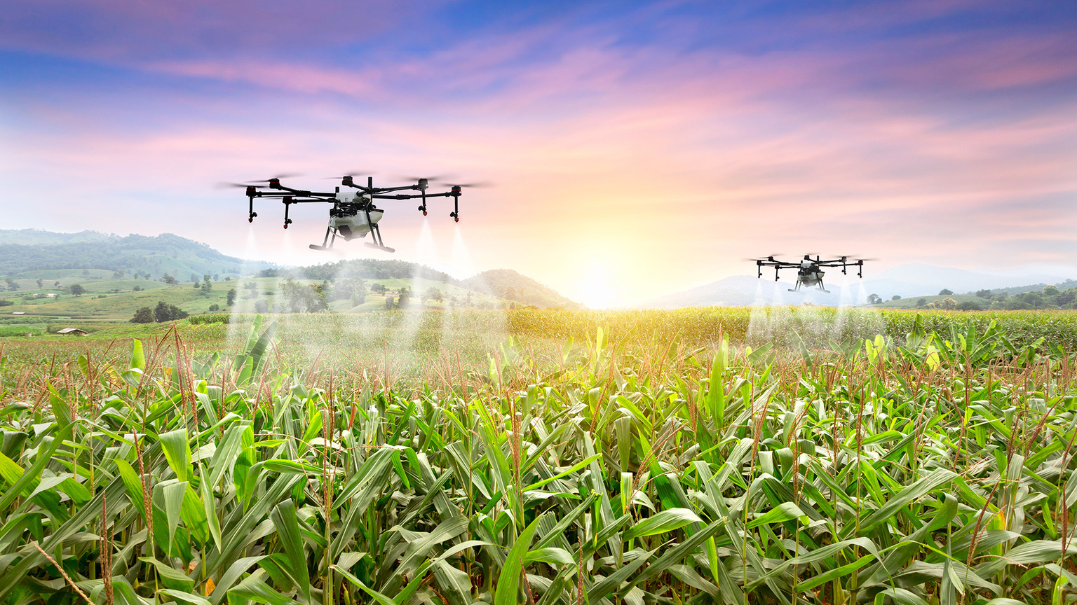

Slide 12
AI (Artificial intelligence)
Data Processing: AI analyzes data from HAPS, drones, and ArcGIS to identify trends, predict crop diseases, and optimize resource usage.
Actionable Insights: Transforms raw data into clear, visual insights using ArcGIS for better decision-making.
Efficiency: Enhances resource management and addresses crop stress early.
Additional Benefits:
Enhanced Decision-Making: AI improves decision-making and automates tasks.
Predictive Analytics: Predicts weather patterns, pest infestations, and crop diseases.
Resource Optimization: Manages water and fertilizer usage efficiently.
Increased Productivity: Boosts crop yields with real-time insights.
Environmental Benefits: Promotes sustainable farming practices.
Digital Twins in Agriculture:
Virtual Replicas: Real-time monitoring and simulation of farms.
Efficiency and Sustainability: Optimizes irrigation, fertilization, and pest management.

Slide 13
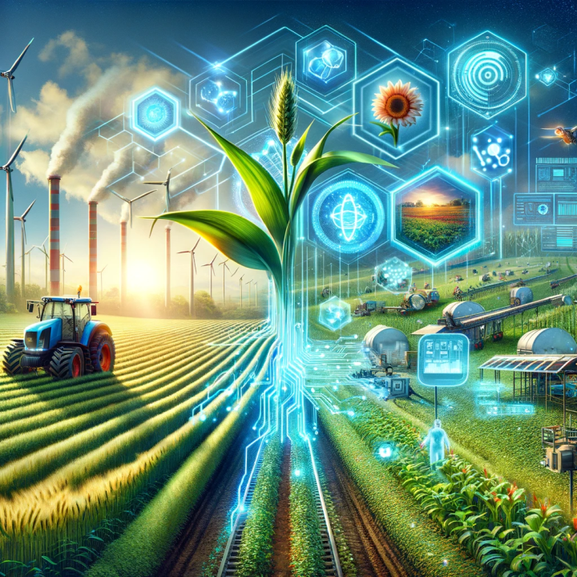
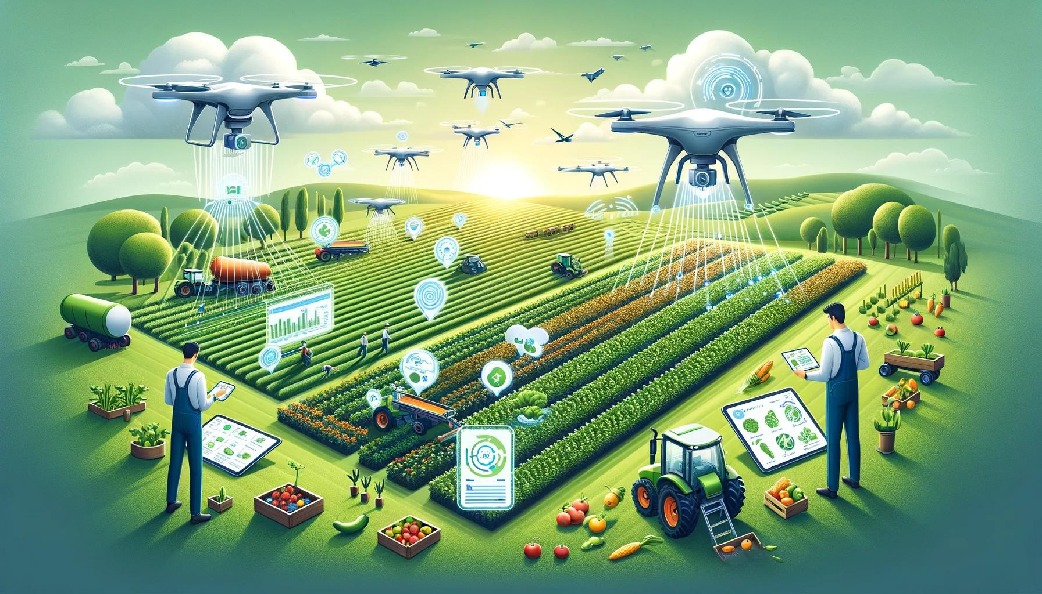

Slide 14
ArcGIS Tecnology
Integrated Data Mapping: Combines data from HAPS, drones, and AI to map crop health, soil conditions, and irrigation needs.
Real-Time Management: Enables efficient resource management by visualizing problem areas in real time.
Issue Identification: Tracks farm progress, detects issues like drought stress or pests, and allows precise interventions.
Informed Decisions: Overlays climate and crop data for comprehensive farm management.
Importance:
Efficiency: Reduces waste and increases productivity.
Proactive Solutions: Allows early detection and timely interventions.
Sustainability: Optimizes resource use for minimal environmental impact.
Scalability: Suitable for both small and large farms.

Slide 15
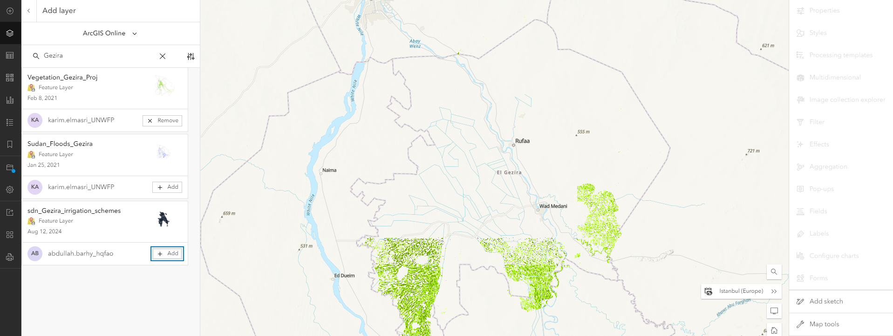
Vegetation_Gezira_Project

Slide 16
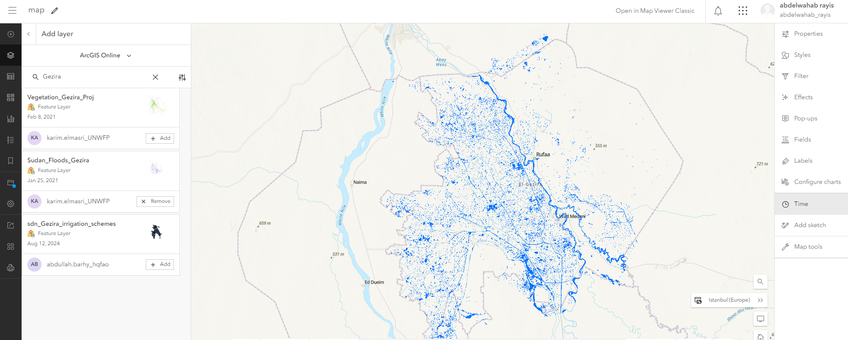
Sudan_Floods_Gezira

Slide 17
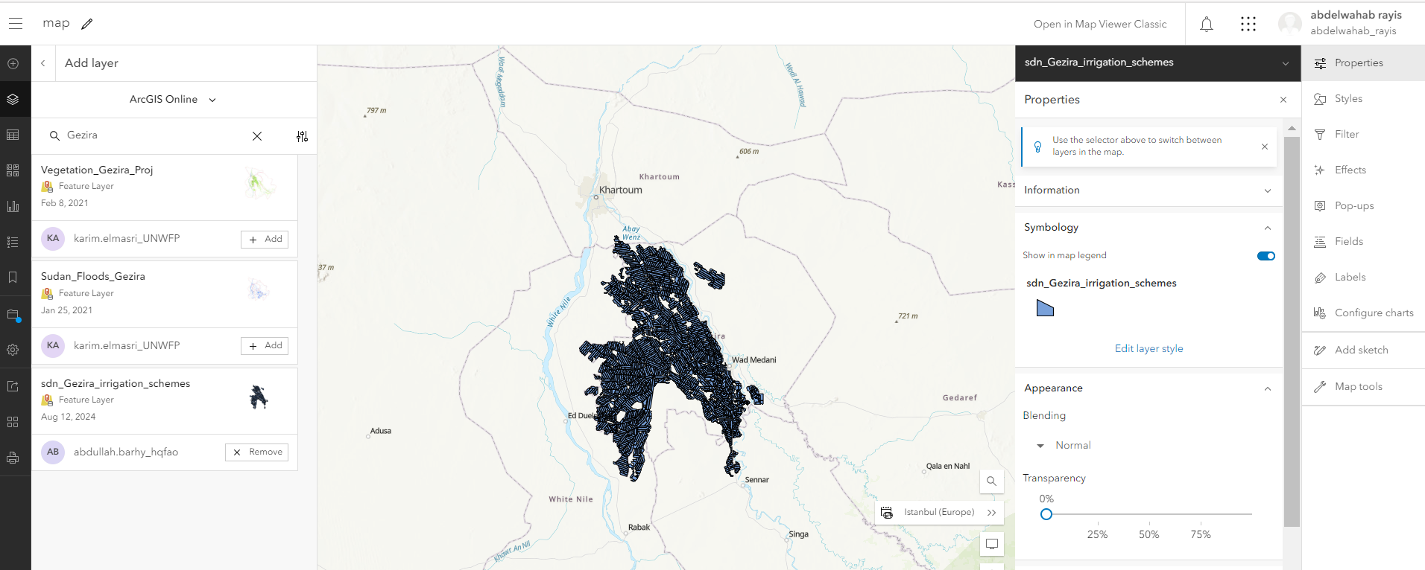
sdn_Gezira_irrigation_schemes

Slide 18
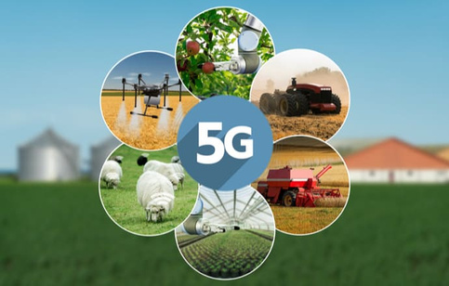
5G Technology
High-Speed Communication: 5G enables high-speed, low-latency communication between HAPS, drones, AI systems, and ground stations.
Immediate Insights: Essential for real-time data transmission in remote farming areas, providing immediate insights for better decision-making.
Real-Time Control: Supports real-time control of drones and seamless integration of data into platforms like ArcGIS.
Enhanced Connectivity: 5G’s high bandwidth and low latency are crucial for real-time data processing and decision-making in agriculture.
IoT Integration: 5G supports a vast number of IoT devices, enabling comprehensive monitoring and automation of farming operations.
Remote Sensing: Facilitates advanced remote sensing capabilities, allowing for precise monitoring of crop health, soil conditions, and environmental factors.

Slide 19
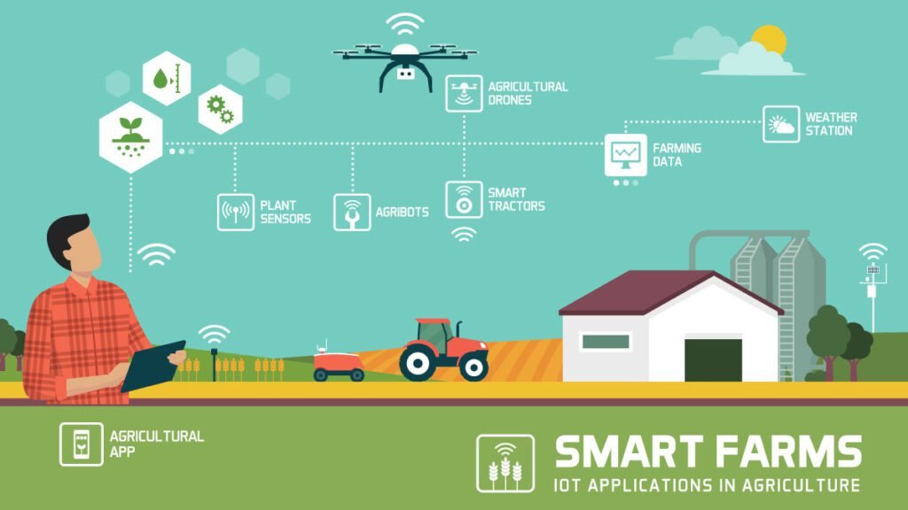

Slide 20
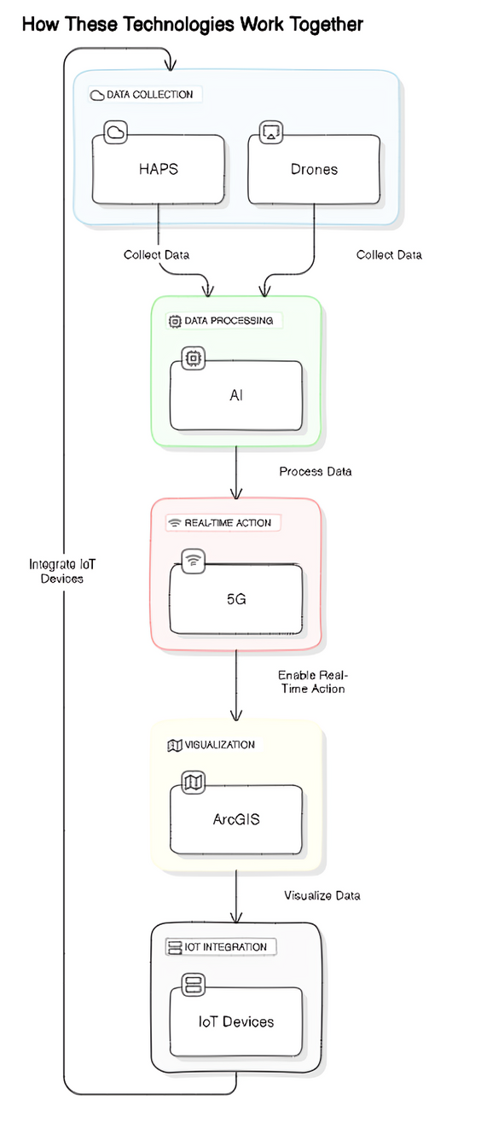
How These Technologies Work Together
Process Overview:
Data Collection:
HAPS and Drones: Collect wide-area and field-specific data.
Data Processing:
AI: Analyzes and integrates data into ArcGIS.
Real-Time Action:
5G: Enables fast data transfer and immediate actions.
Visualization:
ArcGIS: Creates visual maps for better decision-making.
IoT Integration:
IoT Devices: Continuously monitor and feed data into the system.

Slide 21
Case Study:
Example: In Gezira, HAPS and drones can monitor irrigation systems, while ArcGIS tracks field conditions over time.
AI-driven insights can predict and mitigate crop diseases, while geospatial tools ensure efficient resource distribution.
Improved irrigation and pest control can lead to increased yields and reduce water wastage in key agricultural areas.

Slide 22
Sudan_Floods_Gezira

Slide 23
sdn_Gezira_irrigation_schemes

Slide 24
Vegetation_Gezira_Project

Slide 25
Future Outlook for Space and Geospatial Technology in Sudan
Agricultural Benefits: Sudan’s agricultural sector stands to gain significantly from the integration of space and geospatial technologies.
International Collaborations: Partnering with international organizations and space agencies can further advance these technologies.
Investment Needs: Highlighting the importance of investing in space and geospatial technologies, such as ArcGIS, to support Sudan’s agricultural development and sustainability goals.
Capacity Building: Emphasizing the need for training and education to build local expertise in using these advanced technologies.
Policy Support: Advocating for supportive policies and frameworks to facilitate the adoption and integration of space and geospatial technologies in agriculture.

Slide 26
Conclusion
Space technology and geospatial tools, such as HAPS, are revolutionizing agriculture globally. These technologies enhance efficiency, sustainability, and productivity, while addressing local challenges like water scarcity and climate variability. Investing in these innovations is essential for building a resilient and prosperous agricultural future worldwide.

Slide 27
References
1. https://spacefoundatione.maps.arcgis.com/
2. https://hapsalliance.org/wp-content/uploads/2021/12/Day_1-SoftBankHAPSMobile_6G_Concept_and_HAPS-NTN-1.pdf
3. C.L. Nickol; et al. (January 1, 2007). High Altitude Long Endurance Air Vehicle Analysis of Alternatives and Technology Requirements Development (PDF) (Report). NASA.
4. C.L. Nickol; et al. (January 1, 2007). High Altitude Long Endurance Air Vehicle Analysis of Alternatives and Technology Requirements Development (PDF) (Report). NASA.
5. SIMBER A Near Space Lighter than Air Remote Sensing Platform (africa city of technology (osama rayis))
6. Z. Goraj; et al. (2004). "High altitude long endurance unmanned aerial vehicle of a new generation – a design challenge for a low cost, reliable and high performance aircraft" (PDF). Bulletin of the Polish Academy of Sciences, Technical Sciences. Vol. 52, no. 3.
7. T. C. Tozer; D. Grace (June 2001). "High-altitude platforms for wireless communications". Electronics & Communication Engineering Journal. 13 (3): 127–137. doi:10.1049/ecej:20010303.
8. "Advantages of HAPS: (ii) Compared with Satellite Services". SkyLARC Technologies. 2001. Archived from the original on 2006-11-01.

